Slide 2
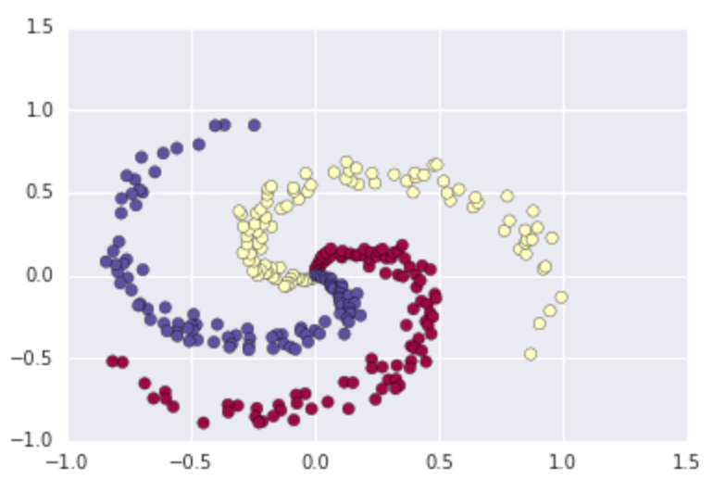
Compute the scores
scores = np.dot(X, W) + b
initialized W, b to random numbers, b will be broadcasted to (300, 3)
X
W
b
scores
300*2
2*3
1*3
300*3
[[-0.04783054 -0.00367269 0.05150323]]
[[ 1.24403118 1.10116721 -2.347785 ] [-2.43834887 2.76791098 -0.34302856]]
300 examples, which belong to 3 classes, each class has 100 examples. Each example has 2 dim
Notes:
http://cs231n.github.io/neural-networks-case-study/#grad

Slide 3
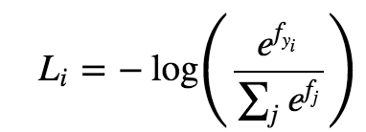

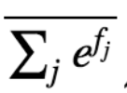
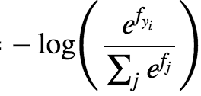
Compute the loss - loss of each example
scores
exp_scores
probs
corect_logprobs
300*3
300*3
300*3
f1
f2
f3
1D array of just the probabilities assigned to the correct classes for each example. (300, )
[ 1.09861229 1.09853183 1.09845107 1.09836357 1.09828875….]

Slide 4
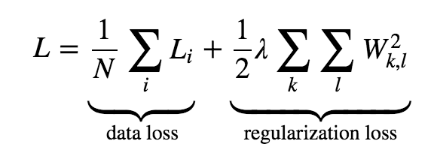
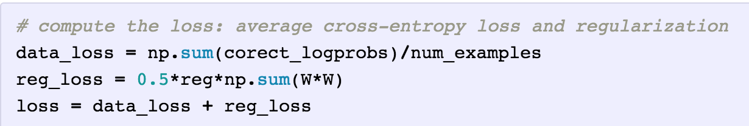
Total loss
corect_logprobs
1D array of just the probabilities assigned to the correct classes for each example. (300, )
[ 1.09861229 1.09853183 1.09845107….]

Slide 5
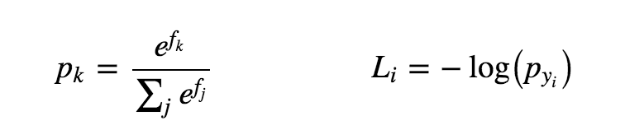
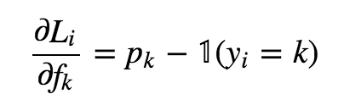
Backpropagation
scores
exp_scores
probs
corect_logprobs
300*3
300*3
p1
p2
p3
[ L1, L2, L3, L4, L5….Li, …..]
f1
f2
f3
300*3
1D array of just the probabilities assigned to the correct classes for each example. (300, )
[ 1.09861229 1.09853183 1.09845107 1.09836357 1.09828875….]

Slide 6
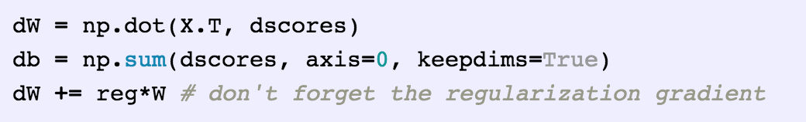
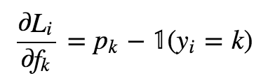

gradient - dW, db
probs
dscores
300*3
p1 p2 p3
300*3
dW, db
[ L1, L2, L3, L4, L5….Li, …..]

Slide 7
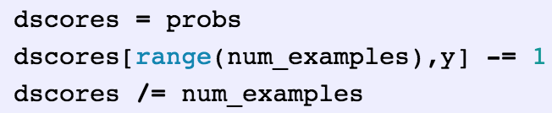
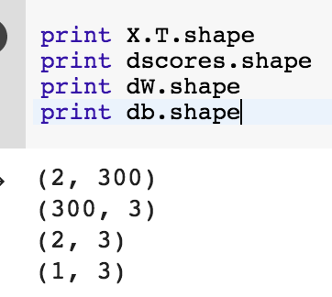
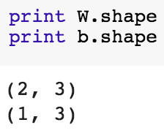
dL/dW = dL/df * df/dW
df/dW = X.T
scores = np.dot(X, W) + b
probs
dscores
300*3
df/dW = X.T
dL/dW = df/dW * dL/df = X.T * dscores
shape(2,3)
df/db = matrix of all 1
dL/db = dL/df * df/db = shape(1,3)
p1 p2 p3
300*3
[ L1, L2, L3, L4, L5….Li, …..]

Slide 8
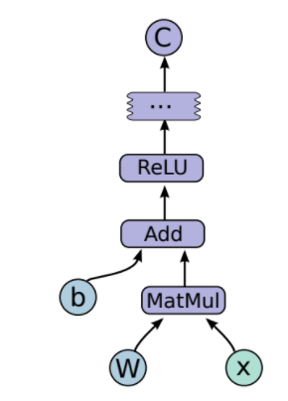
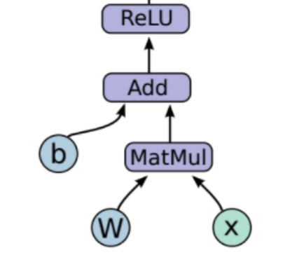
Neural Network
2 layers, 1 hidden layer, We will now need two sets of weights and biases (for the first and second layers).
hidden_layer * W2 + b2

Slide 9
Compute the scores
scores = np.dot(X, W) + b
initialized W, b to random numbers, b will be broadcasted to (300, 3)
X
W
b
scores
300*2
2*3
1*3
300*3
scores
X
hidden_layer
hidden_layer
W2
W
b
b2
300*3
300*2
300*
100
300*
100
100*
3
2*100
1*100
1*3

Slide 10
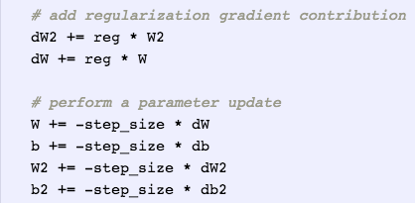
hidden_layer=max(WX+b)
hidden_lyaer
scores=W2*hidden_layer+b2
# compute the class probabilities
exp_scores = np.exp(scores) probs = exp_scores / np.sum(exp_scores, axis=1, keepdims=True) # [N x K]
W*X+b
ReLU
forward
backward
[ L1, L2, L3, L4, L5….Li, …..]
dW2
dW2 = np.dot(hidden_layer.T, dscores) # (100,3) db2 = np.sum(dscores, axis=0, keepdims=True)
# (1,3)
100*
3
probs
db2
dscores
300*3
p1 p2 p3
1*3
300*3
dW
dscores = probs dscores[range(num_examples),y] - = 1 dscores /= num_examples
2*100
# finally into W,b
dW = np.dot(X.T, dhidden)
db = np.sum(dhidden, axis=0, keepdims=True)
# backprop the ReLU non-linearity
dhidden[hidden_layer <= 0] = 0
dhidden
300*
100
db
1*100
dhidden = np.dot(dscores, W2.T)
Notes:
probs are used when calculating the gradient dscores. According to chain rule, dscores will be used later when calculating dW2 , db2, and dhidden.
Then dhidden is used when calculating dW, db

Slide 12
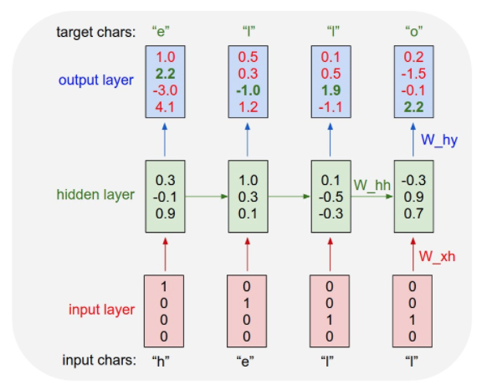
RNN
ys={0:[[1.0,2.2,-3.0, 4.1]], 1:[[0.5,0.3,-1.0,1.2]] }
ix_to_char = {0:’h’, 1:’e’, 2:’l’, 3:’l’, 4:’o’}
inputs = {0,1} # h, e
targets = {1,2} # e, l
1.0
2.2
-3.0
4.1
0.5
0.3
-1.0
1.2
loss
W_hy
W_hy
4*3
4*3
W_hh
W_hh
3*3
3*3
0
0
0
0.3
-0.1
0.9
1.0
0.3
0.1
hs={-1:[[0,0,0]], 0:[[0.3,-0.1,0.9]], }
W_xh
W_xh
3*4
3*4
1
0
0
0
0
1
0
0
xs={0:[[1,0,0,0]], 0:[[0,1,0,0]] }

Slide 13
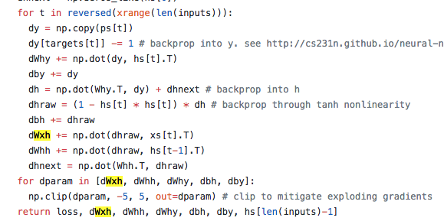
RNN - backprop
ys={0:[[1.0,2.2,-3.0, 4.1]], 1:[[0.5,0.3,-1.0,1.2]] }
ix_to_char = {0:’h’, 1:’e’, 2:’l’, 3:’l’, 4:’o’}
inputs = {0,1} # h, e
targets = {1,2} # e, l
1.0
2.2
-3.0
4.1
0.5
0.3
-1.0
1.2
loss
W_hy
W_hy
4*3
4*3
W_hh
W_hh
3*3
3*3
0
0
0
0.3
-0.1
0.9
1.0
0.3
0.1
hs={-1:[[0,0,0]], 0:[[0.3,-0.1,0.9]], }
W_xh
W_xh
3*4
3*4
1
0
0
0
0
1
0
0
xs={0:[[1,0,0,0]], 0:[[0,1,0,0]] }
Notes:
backprop

Slide 14
Train
ix_to_char = {0:’h’, 1:’e’, 2:’l’, 3:’l’, 4:’o’}
inputs = {0,1} # h, e
targets = {1,2} # e, l
inputs = l , l
targets = l, o
loss, dWxh, dWhh, dWhy, dbh, dby, hprev = lossFun(inputs, targets, hprev)
Notes:
Each time 2 chars as input, and we know the targets, then forward, backward to update the weights.
For testing, just using the weights we current have, try sample char by char, and see it makes sense or not.
start with one char, then predict what’s the next char, then put the predicted char back, and predict the next one.

